Slide 1

Contact tracing
Predicting disease outbreaks

Slide 2
Problem Statement:
Predicting outbreaks and Contact Tracing:
We all have witnessed the outbreak of Covid-19 pandemic. Can we use data science and allied technologies to predict the outcome of such pandemics in future?

Slide 3

Our big idea
A Contact Tracing Model is designed to combat the disease outbreak by incorporating Clustering/DBSCAN Algorithms, which fall under the realm of Machine Learning.

Slide 4
Current scenario
When a newly emerging infectious disease breaks out in a country, it brings critical damage to both human health conditions and the national economy.
Contact tracing is a valuable method of stopping disease spread of any kind. It is currently being used to help prevent the spread of the COVID-19 pandemic.

Slide 5
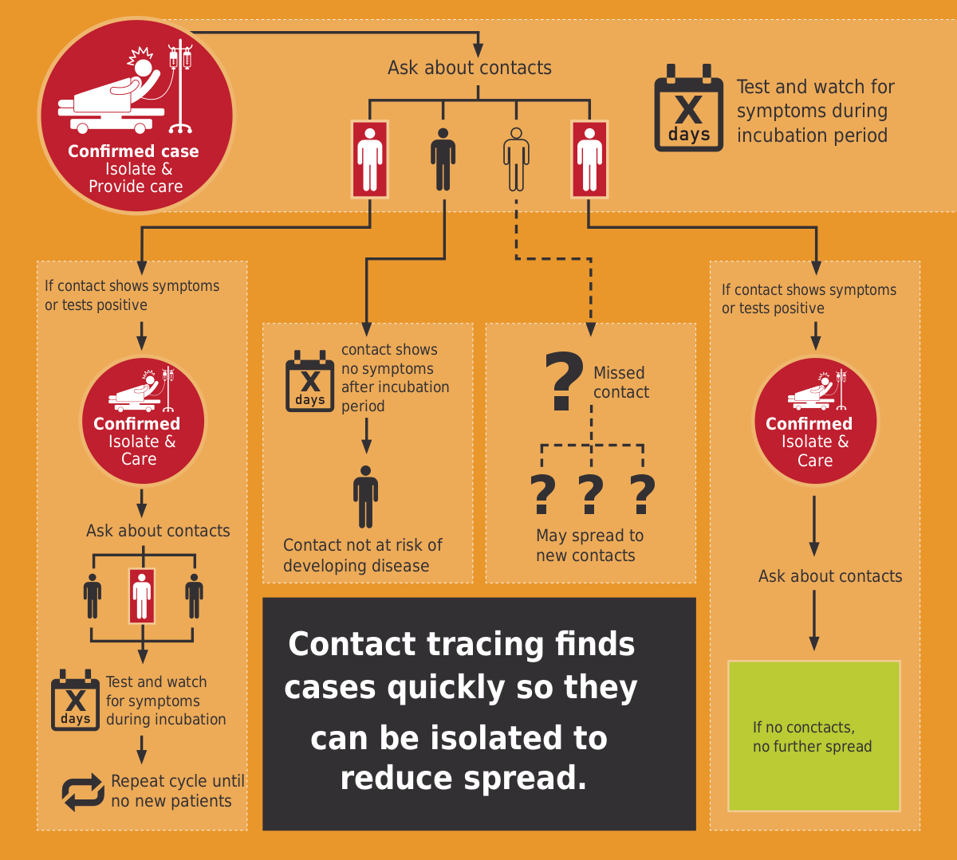

Slide 6
Our approach towards solution
DBSCAN algorithm groups data points close to each other and marks outlier data points as noise.
The DBSCAN model, using this model we will generate clusters, which will help identify infections by filtering the data in the clusters.JavaScript Object Notation (JSON) is a standard text-based format for representing structured data based on JavaScript object syntax.

Slide 7
Steps we followed
Get location data of different users within a specific time and place.
Apply a density-based clustering algorithm on the data.
Use the clusters to predict infected people.

Slide 8
Technologies:
Machine learning
Html & CSS
Deployment Tools:
Flask
Pickle

Slide 9


